Slide 1
CE 395 R5 - Data Mining Classification & Prediction (Artificial Neural Networks)

Slide 2
Neural Networks
Analogy to Biological Systems
Massive Parallelism allowing for computational efficiency
The first learning algorithm came in 1959 (Rosenblatt) who suggested that if a target output value is provided for a single neuron with fixed inputs, one can incrementally change weights to learn to produce these outputs using the perceptron learning rule

Slide 3
Definition of Neural Network
A Neural Network is a system composed of many simple processing elements operating in parallel which can acquire, store, and utilize experiential knowledge

Slide 4
Neural Network Components
- Each element is a node called unit
- Units are connected by links
- Each link has a numeric weight

Slide 5
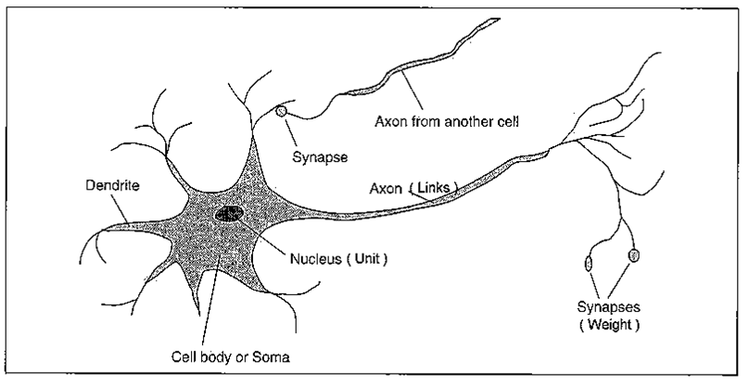
Neurons vs. Units (2)

Slide 6
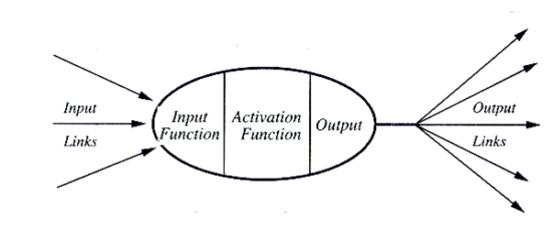
Computing Elements
A typical unit:

Slide 7
Building a Neural Network
Require decisions on:
- The number of units to use
- The type of units required
- Connection between the units

Slide 8
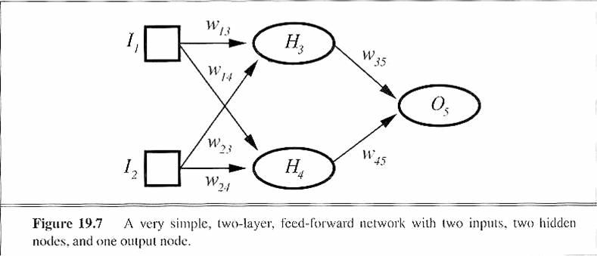
Neural Network Example

Slide 9
NN Computations
- 2 components: Linear and Non-linear
- Linear: Input function
- calculate weighted sum of all inputs
- Non-linear: Activation function
- transform sum into activation level

Slide 10


NN Computations (2)
Input function:
Activation function:

Slide 11
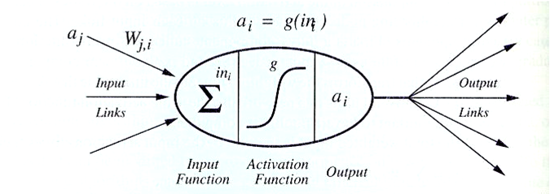
NN Computing Unit

Slide 12
Activation Functions
Use different functions to obtain different models
3 most common choices:
1) Step function
2) Sign function
3) Sigmoid function

Slide 13
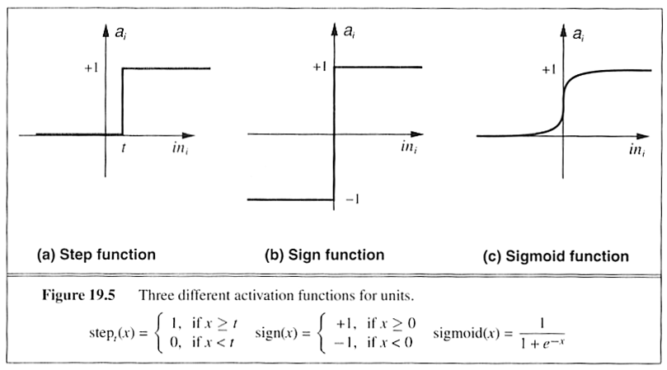
Activation Functions

Slide 14
Network Structures
Feed-forward:
Links can only go in one direction
Recurrent:
Links can go anywhere and form arbitrary topologies

Slide 15
Feed-Forward Neural Networks (FF NN)
Arranged in layers
Each unit is linked only in the unit in next layer
No units are linked between the same layer, back to the previous layer or skipping a layer
Computations can proceed uniformly from input to output units

Slide 16
General Structure of FF NN
Training NN means learning the weights of the neurons

Slide 17
Multi-layer Networks
Have one or more layers of hidden units
With two possibly very large hidden layers, it is possible to implement any function
Networks without hidden layer are called perceptrons

Slide 18
Perceptrons
First studied in the late 1950s.
The only efficient learning element at that time was for single-layered networks.
Perceptrons are very limited in what they can represent, but this makes their learning problem much simpler
Today, used as a synonym for a single-layer, feed-forward network.

Slide 19
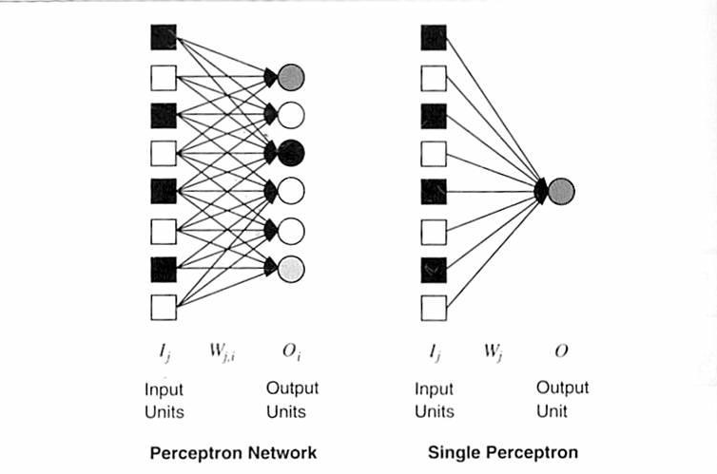
Perceptrons

Slide 20
What can Perceptrons Represent ?
What can perceptrons represent ?
Linearly separable functions (e.g.: some Boolean functions)
Bad news:
There are not many linearly separable functions
Good news:
There is a perceptron algorithm that will learn
any linearly separable function, given enough
training examples.

Slide 21
NN Learning
- Initial network has a randomly assigned weights
- Weight adjustments are made to reduce the difference between the observed and predicted values
- Need to repeat the update phase several times in order to achieve convergence.
- Updating process is divided into epochs, each epoch
updates all the weights of the process.

Slide 22
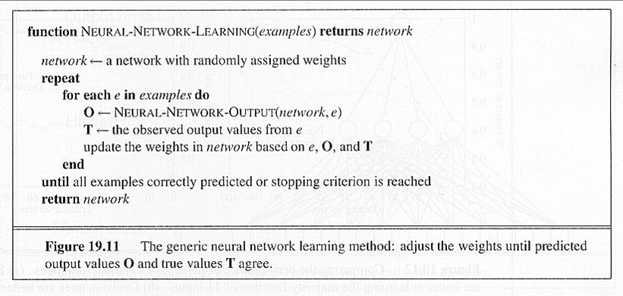
NN Learning (2)

Slide 23
Artificial Neural Networks (ANN)
Output Y is 1 if at least two of the three inputs are equal to 1.

Slide 24
Artificial Neural Networks (ANN)

Slide 25
Artificial Neural Networks (ANN)
Model is an assembly of inter-connected nodes and weighted links
Output node sums up each of its input value according to the weights of its links
Compare output node against some threshold t
Perceptron Model

Slide 26
Introduction to Backpropagation
In 1969 a method for learning in multi-layer network, Backpropagation, was invented by Bryson and Ho.
The Backpropagation algorithm is a sensible approach for dividing the contribution of each weight.
Works basically the same as perceptrons
Can model complex functions

Slide 27
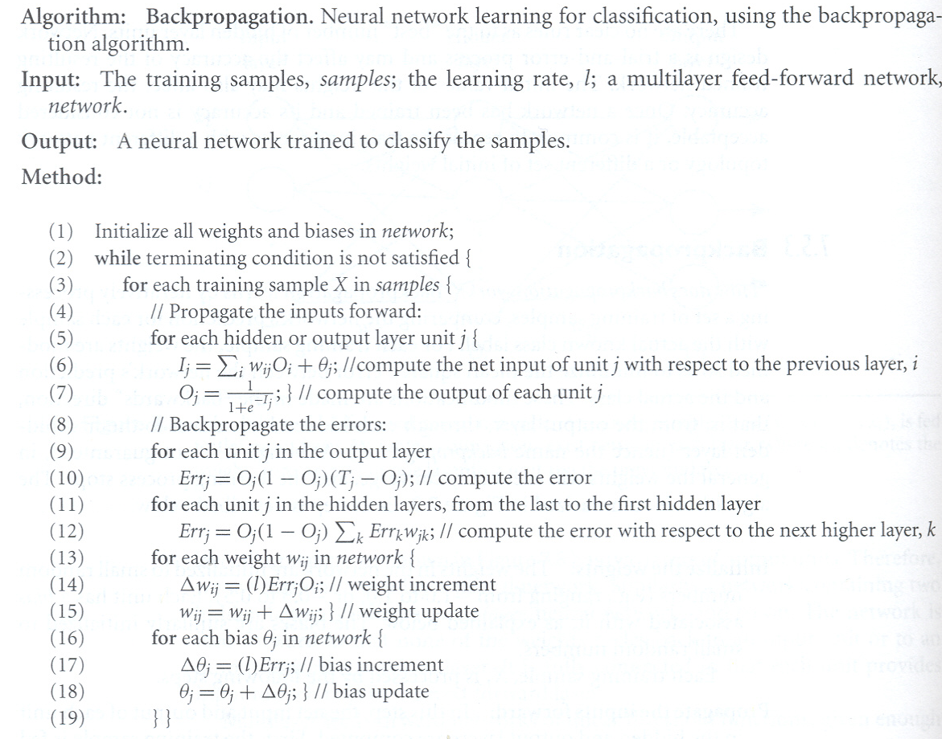
Backpropagation Algorithm(1)
(source: Han and Kamber, 2001)

Slide 28
Backpropagation Algorithm(2)
The ideas of the algorithm can be summarized as follows:
Computes the error term for the output units using the observed error
From output layer, repeat propagating the error term back to the previous layer and updating the weights between the two layers until the earliest hidden layer is reached

Slide 29
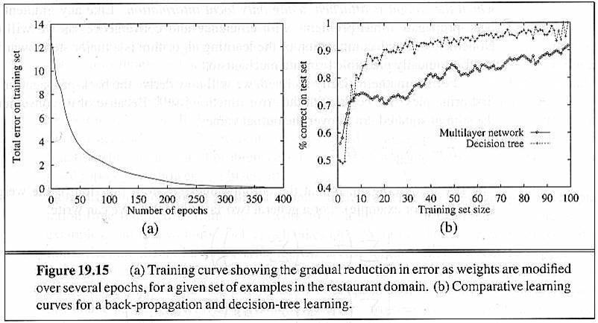
Examples of Backpropagation Learning

Slide 30
Design Issues in ANN
Number of nodes in input layer
Number of nodes in output layer
Number of nodes in hidden layer
Initial weights and biases

Slide 31
Characteristics of ANN
Multilayer ANN are universal approximators but could suffer from overfitting if the network is too large
Model building can be very time consuming, but testing can be very fast
Can handle redundant attributes because weights are automatically learnt
Sensitive to noise in training data
Difficult to handle missing attributes

